Slide 1


Supermarket Sales Dashboard
Hello I am shaily kesharwani

Slide 2
About Dashboard
A supermarket sales dashboard is a great tool for keeping track of the sales performance of a grocery store. It provides a visual overview of the store's performance and helps store managers identify areas of strength and weakness. The dashboard typically includes a variety of charts and graphs that show sales figures, Profit, Loss and other key metrics. It also shows the performance of every Year, every month and allowing store managers to quickly identify areas where they need to take action. By tracking sales performance, store managers can adjust their strategies to maximize sales and profits.

Slide 3
Steps on making Dashboard
1. Gather the relevant data: Sales data from the supermarket should be collected on a regular basis. This data should include information such as total sales, total customers, product ID , and Mode of payment etc.
2. Analyze the data: Once the data is collected, it should be analyzed to identify patterns and trends. This analysis can help uncover important insights such as which products are popular, which products need to be promoted, and which products have higher margins.
3. Create the dashboard: Once the data is collected and analyzed, it can be used to create a dashboard. The dashboard should include visualizations such as charts and graphs that will provide insights into the sales data.
4. Test the dashboard: Once the dashboard is created, it should be tested for accuracy and usability. This will ensure that the dashboard is delivering the information that it was intended to.
5. Publish the dashboard: Finally, the dashboard should be published so that it can be accessed and used by store managers and other stakeholders. This will allow them to make informed decisions based on the data presented in the dashboard.

Slide 4
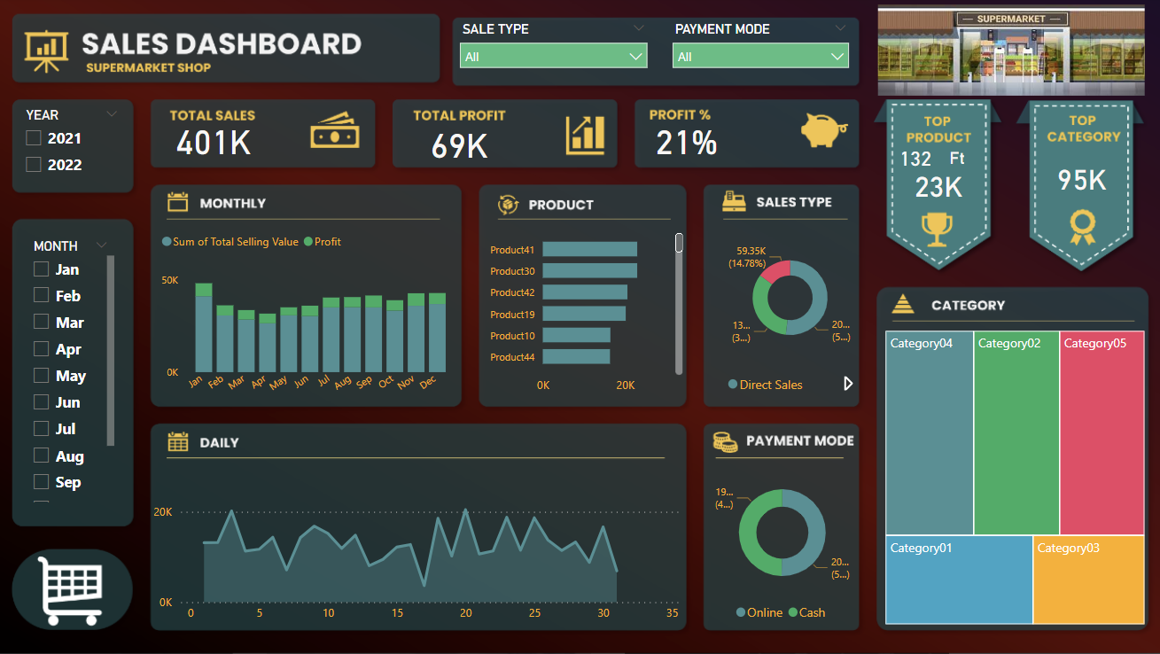

Slide 5
Thank You

